Slide 1
Normalization of Database Tables
Module 10
Prepared by: Engr. Ryan D. Francisco

Slide 2
Database Tables and Normalization
Normalization
Process for evaluating and correcting table structures to minimize data redundancies
Reduces data anomalies
Series of stages called normal forms:
First normal form (1NF)
Second normal form (2NF)
Third normal form (3NF)

Slide 3
Database Tables and Normalization (cont’d.)
Normalization (continued)
2NF is better than 1NF; 3NF is better than 2NF
For most business database design purposes, 3NF is as high as needed in normalization
Highest level of normalization is not always most desirable
Denormalization produces a lower normal form
Increased performance but greater data redundancy

Slide 4
The Need for Normalization
Example: company that manages building projects
Charges its clients by billing hours spent on each contract
Hourly billing rate is dependent on employee’s position
Periodically, report is generated that contains information such as displayed in Table 6.1

Slide 5
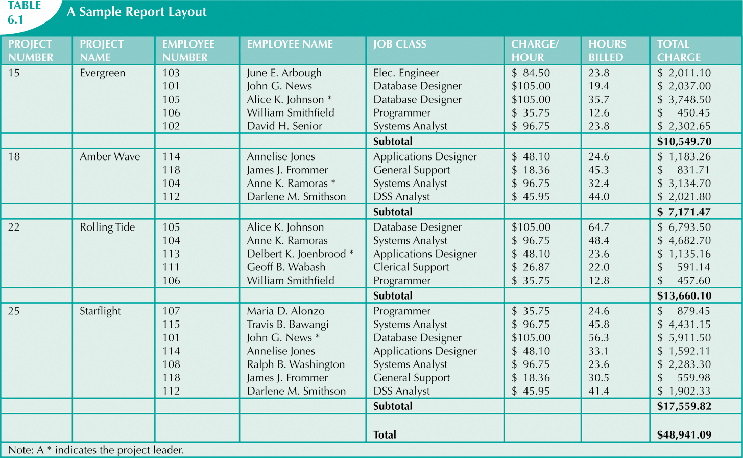

Slide 6
The Need for Normalization (cont’d.)
Structure of data set in Figure 6.1 does not handle data very well
Table structure appears to work; report is generated with ease
Relational database environment is suited to help designer avoid data integrity problems

Slide 7
The Normalization Process
Each table represents a single subject
No data item will be unnecessarily stored in more than one table
All nonprime attributes in a table are dependent on the primary key
Each table is void of insertion, update, and deletion anomalies

Slide 8
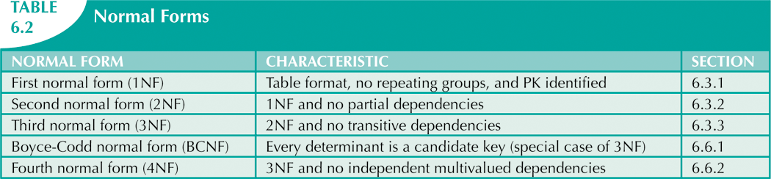

Slide 9
The Normalization Process (cont’d.)
Objective of normalization is to ensure that all tables are in at least 3NF
Higher forms are not likely to be encountered in business environment
Progressively breaks table into new set of relations based on identified dependencies

Slide 10
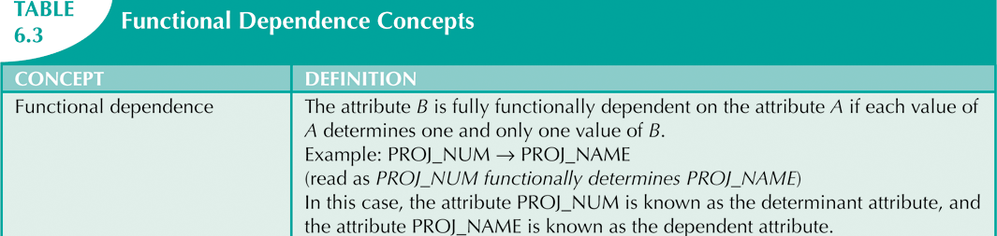

Slide 11
The Normalization Process (cont’d.)
Partial dependency
Exists when there is a functional dependence in which the determinant is only part of the primary key
Transitive dependency
Exists when there are functional dependencies such that X → Y, Y → Z, and X is the primary key

Slide 12
Conversion to First Normal Form
Relational table must not contain repeating groups
Normalizing table structure will reduce data redundancies
Normalization is three-step procedure

Slide 13
Conversion to First Normal Form (cont’d.)
Step 1: Eliminate the Repeating Groups
Eliminate nulls: each repeating group attribute contains an appropriate data value
Step 2: Identify the Primary Key
Must uniquely identify attribute value
New key must be composed
Step 3: Identify All Dependencies
Dependencies are depicted with a diagram

Slide 14
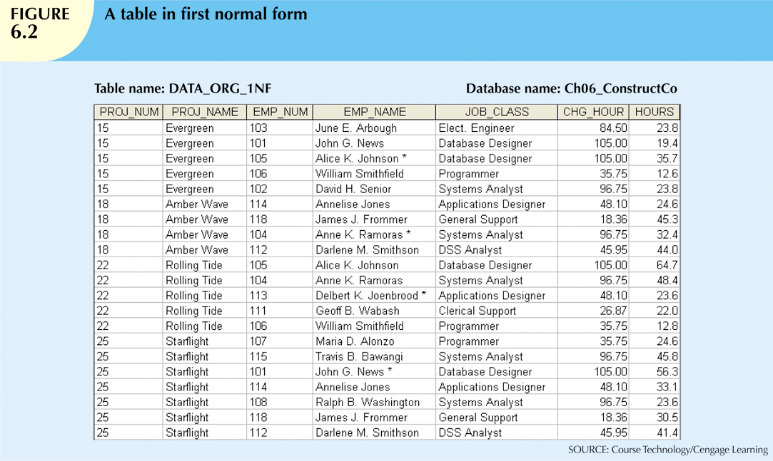

Slide 15
Conversion to First Normal Form (cont’d.)
Dependency diagram:
Depicts all dependencies found within given table structure
Helpful in getting bird’s-eye view of all relationships among table’s attributes
Makes it less likely that you will overlook an important dependency

Slide 16
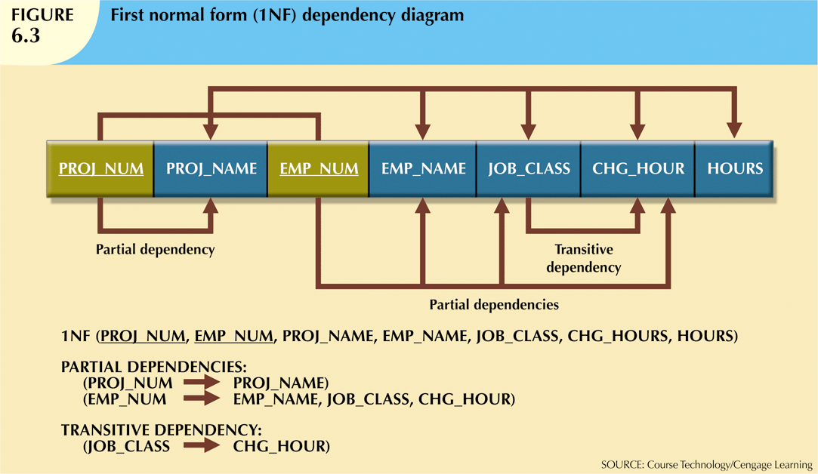

Slide 17
Conversion to First Normal Form (cont’d.)
First normal form describes tabular format:
All key attributes are defined
No repeating groups in the table
All attributes are dependent on primary key
All relational tables satisfy 1NF requirements
Some tables contain partial dependencies
Dependencies are based on part of the primary key

Slide 18
Conversion to Second Normal Form
Step 1: Make New Tables to Eliminate Partial Dependencies
Write each key component on separate line, then write original (composite) key on last line
Each component will become key in new table
Step 2: Reassign Corresponding Dependent Attributes
Determine attributes that are dependent on other attributes
At this point, most anomalies have been eliminated

Slide 19
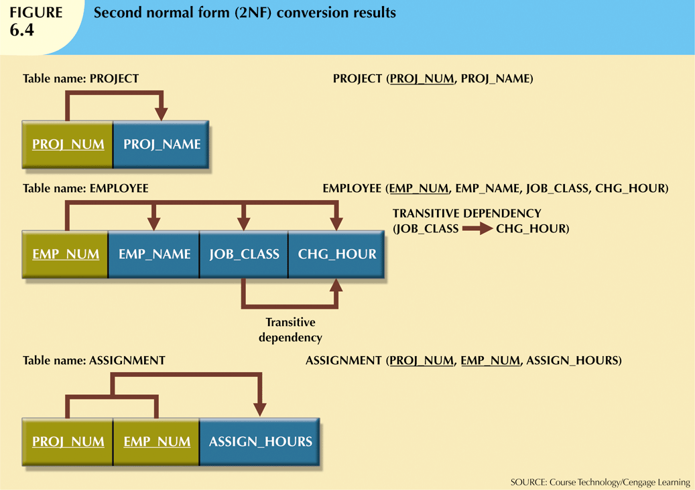

Slide 20
Conversion to Second Normal Form (cont’d.)
Table is in second normal form (2NF) when:
It is in 1NF and
It includes no partial dependencies:
No attribute is dependent on only portion of primary key

Slide 21
Conversion to Third Normal Form
Step 1: Make New Tables to Eliminate Transitive Dependencies
For every transitive dependency, write its determinant as PK for new table
Determinant: any attribute whose value determines other values within a row

Slide 22
Conversion to Third Normal Form (cont’d.)
Step 2: Reassign Corresponding Dependent Attributes
Identify attributes dependent on each determinant identified in Step 1
Name table to reflect its contents and function

Slide 23
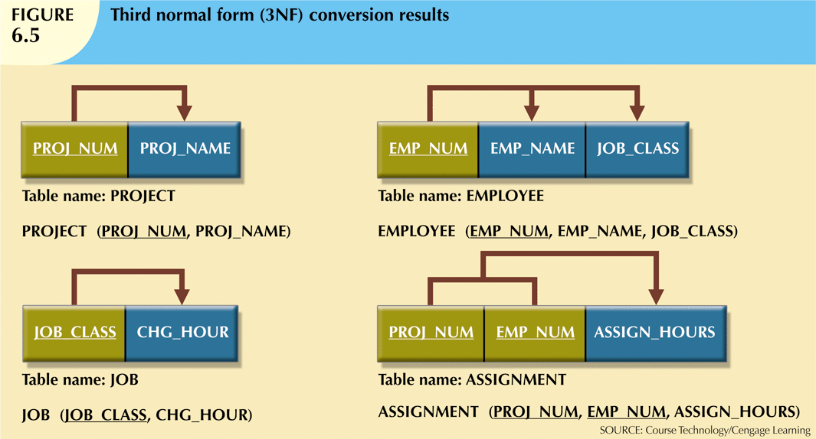

Slide 24
Conversion to Third Normal Form (cont’d.)
A table is in third normal form (3NF) when both of the following are true:
It is in 2NF
It contains no transitive dependencies

Slide 25
Higher-Level Normal Forms
Tables in 3NF perform suitably in business transactional databases
Higher-order normal forms are useful on occasion
Two special cases of 3NF:
Boyce-Codd normal form (BCNF)
Fourth normal form (4NF)

Slide 26
The Boyce-Codd Normal Form
Every determinant in table is a candidate key
Has same characteristics as primary key, but for some reason, not chosen to be primary key
When table contains only one candidate key, the 3NF and the BCNF are equivalent
BCNF can be violated only when table contains more than one candidate key

Slide 27
The Boyce-Codd Normal Form (cont’d.)
Most designers consider the BCNF as a special case of 3NF
Table is in 3NF when it is in 2NF and there are no transitive dependencies
Table can be in 3NF and fail to meet BCNF
No partial dependencies, nor does it contain transitive dependencies
A nonkey attribute is the determinant of a key attribute

Slide 28
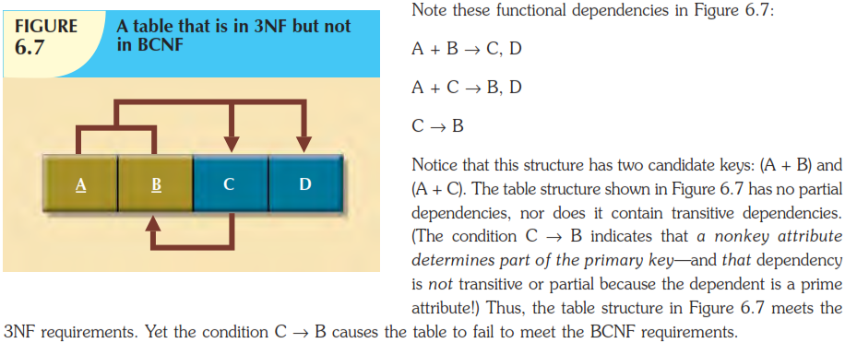

Slide 29
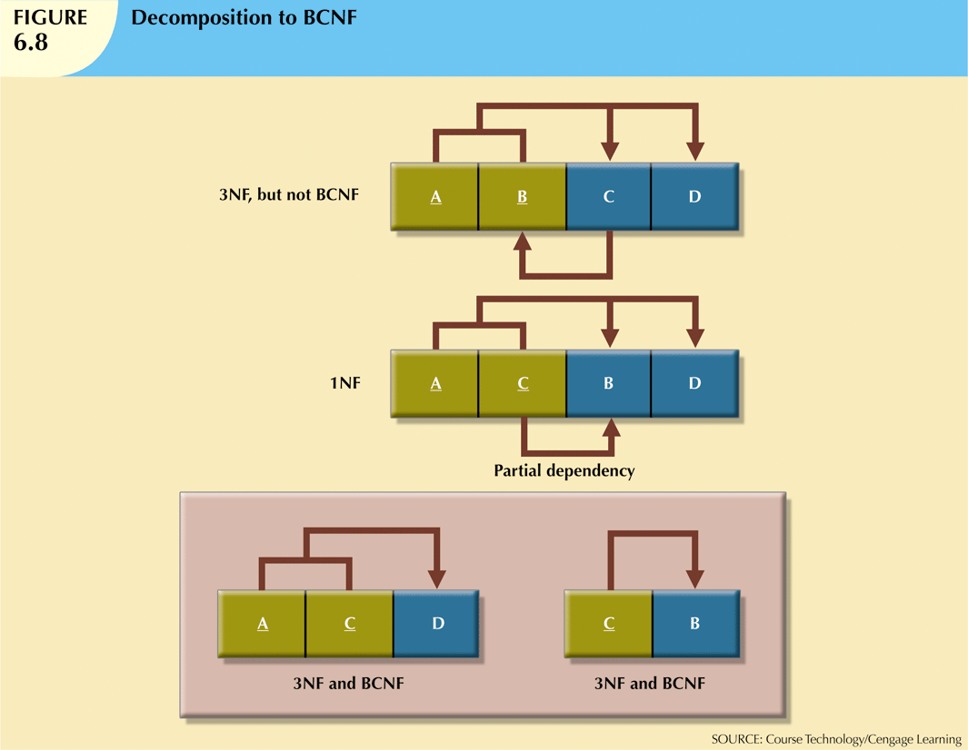

Slide 30
Fourth Normal Form (4NF)
Table is in fourth normal form (4NF) when both of the following are true:
It is in 3NF
No multiple sets of multivalued dependencies
4NF is largely academic if tables conform to following two rules:
All attributes dependent on primary key, independent of each other
No row contains two or more multivalued facts about an entity

Slide 31
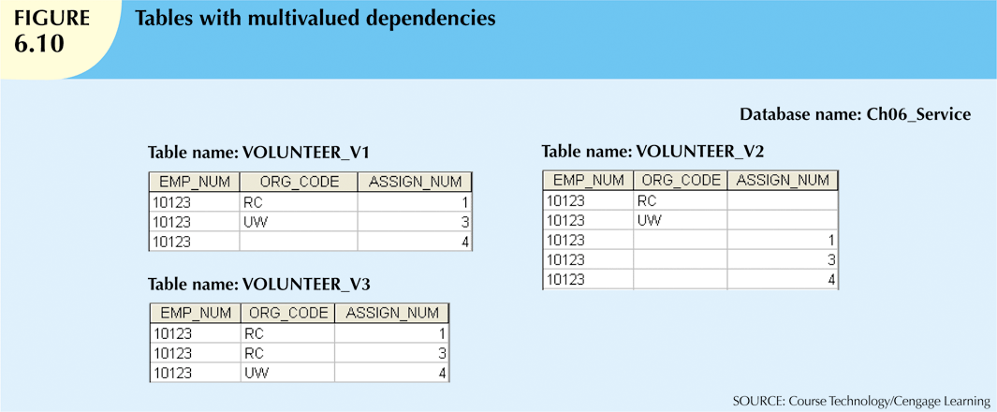
The same employee might be assigned to work on three projects: 1, 3, and 4. Figure 6.10 illustrates how that set of facts can be recorded in very different ways.
There is a problem with the tables in Figure 6.10. The attributes ORG_CODE and ASSIGN_NUM each may have many different values.
In normalization terminology, this situation is referred to as a multivalued dependency. A multivalued dependency occurs when one key determines multiple values of two other attributes and those attributes are independent of each other. (One employee can have many service entries and many assignment entries. Therefore, one EMP_NUM can determine multiple values of ORG_CODE and multiple values of ASSIGN_NUM; however, ORG_CODE and ASSIGN_NUM are independent of each other.)

Slide 32
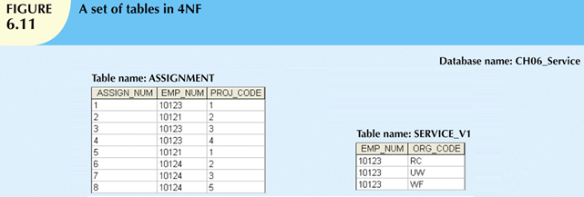

Slide 33
Denormalization
Creation of normalized relations is important database design goal
Processing requirements should also be a goal
If tables are decomposed to conform to normalization requirements:
Number of database tables expands

Slide 34
Denormalization (cont’d.)
Joining the larger number of tables reduces system speed
Conflicts are often resolved through compromises that may include denormalization
Defects of unnormalized tables:
Data updates are less efficient because tables are larger
Indexing is more cumbersome
No simple strategies for creating virtual tables known as views

